Slide 1

AIRBNB Price Prediction.

Slide 2
Recap
Overview: What triggers the Airbnb rental price?
Solution: Analyse the factors that influence the rental price and develop models that captures the complexity of the pricing system.
Impact: Provides interesting insights that can benefit a host looking to maximize their profit.

Slide 3
Dataset and preprocessing.
Dataset:
Comprises information on Airbnb listings in USA with 74111 rows and 29 columns
Preprocessing:
Data cleaning: Almost clean !
Scaling: Scale numerical features to similar range.
Encoding: Label encoding.
Feature selection : Identify the key features that are likely to influence.

Slide 4
Important Findings in EDA.
Data Distribution: Normal distribution.
Data Quality: Missing values and outliers were handled appropriately.
Patterns and trends: To understand underlying relationships and phenomena of data through visualization.
Correlation: Analyze multicollinearity.
Feature importance: Determining which features are most relevant for the target variable through visual inspection.

Slide 5
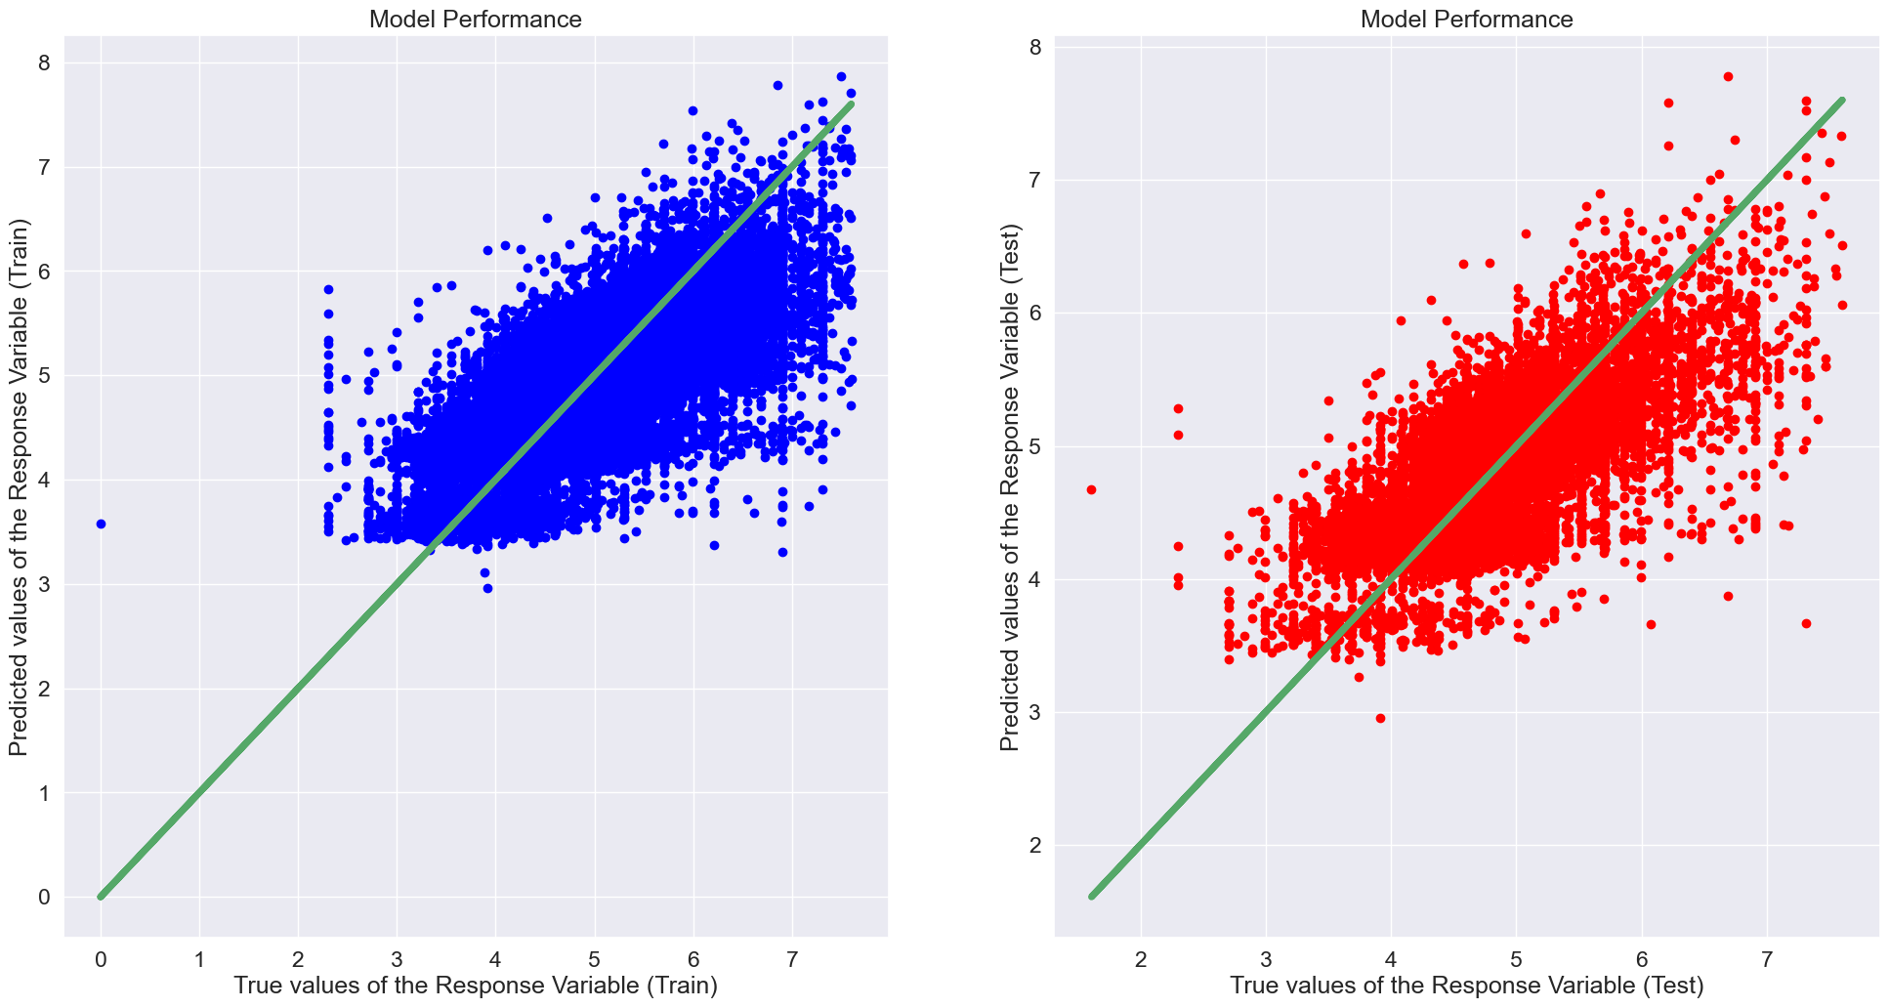
Baseline model and evaluation metrics.
Baseline Model : Linear Regression
Mean Absolute Error (MAE): 0.36
Mean Squared Error (MSE): 0.23
Root Mean Squared Error (RMSE): 0.48
R-squared (R2) Score: 0.54

Slide 6
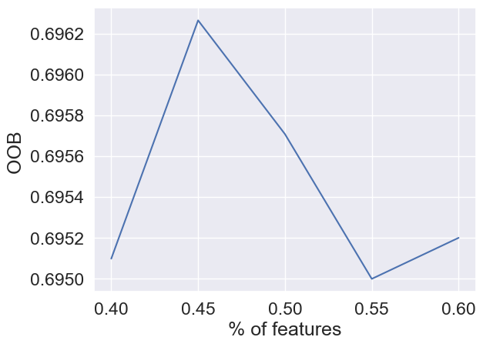
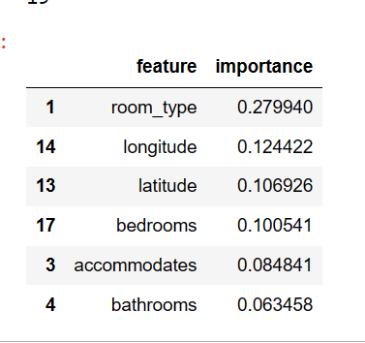
Random Forest Regressor
Importance
OOB Score: 70%

Slide 7
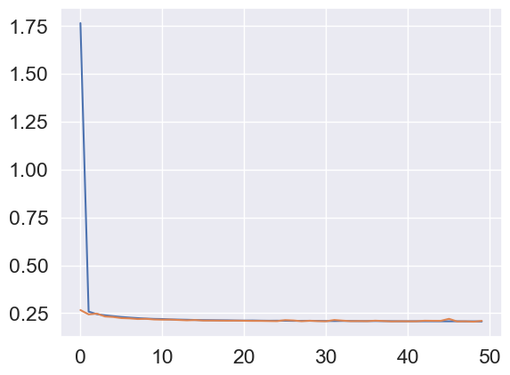
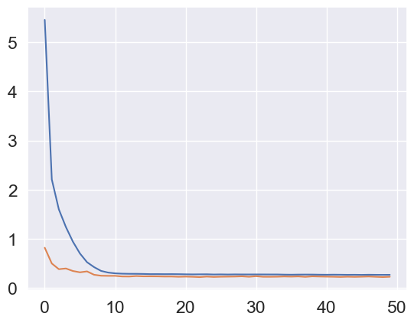
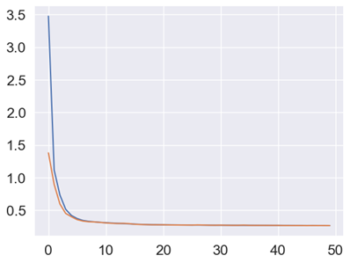
Neural Network
No feature selection
MAE: 0.33
With PCA
MAE: 0.34
With Drop-out
MAE: 0.36
With Regularisation
MAE: 0.33

Slide 8
Comparison of models
Linear Regression: 54%
Random Forest: 70%
L1 Regularization: MAE: 0.33

Slide 9
Thank you! Any questions?

